Slide 1
HMS 520 - Final Project
Team members: Caroline Stein and Hasan Nassereldine
December 14

Slide 2
Refactoring a piece of existing code
Goal of the project: Implement improvements in an existing code, for readability and/or extendability, using data wrangling and modeling tools in R.
Dataset: variables related to the vaccine efficacy at preventing infection and/or severe disease while considering time (weeks) since the second dose. The dataset is updated with newly available data. Therefore, the objective is to have a code that produces all outputs at once for the various variables in the dataset.
Improvements: variable names, a loop for the analysis considering vaccine, outcomes, and time since vaccination.

Slide 3
Time since vaccination dataset
Vaccine developer: Pfizer & BioNTech, Moderna, Johnson & Johnson, and AstraZeneca
Outcomes: asymptomatic infections, symptomatic infections, and severe disease (defined as Hospitalization and/or deaths)
Time since vaccination: number of weeks after receiving the second dose (1st dose in case of J&J)

Slide 4
Refactoring a piece of existing code
Existing code: ~500 lines of code (~100 lines of code by Vaccine)
Refactored code: ~150 lines of code because a loop was implemented which produced a combined spreadsheet and plots by vaccine and outcomes
R Demo: to show how quickly is running the code with the Loop and saving time
Outputs:
combined dataset
15 plots

Slide 5
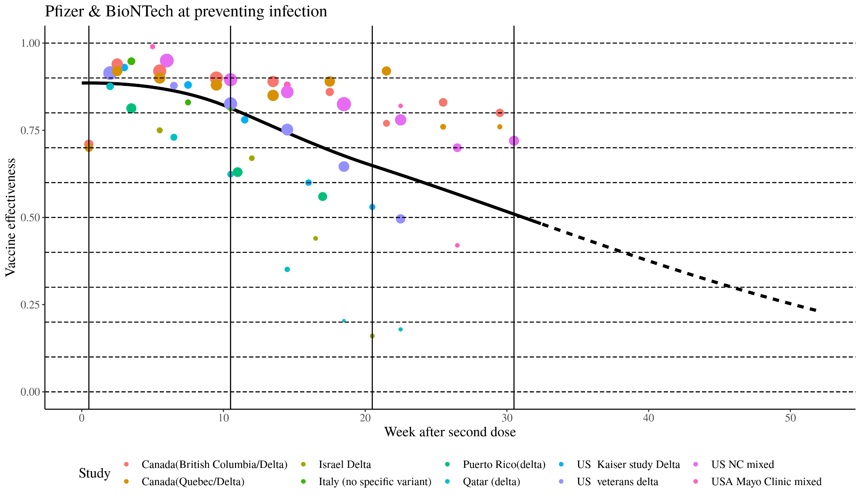
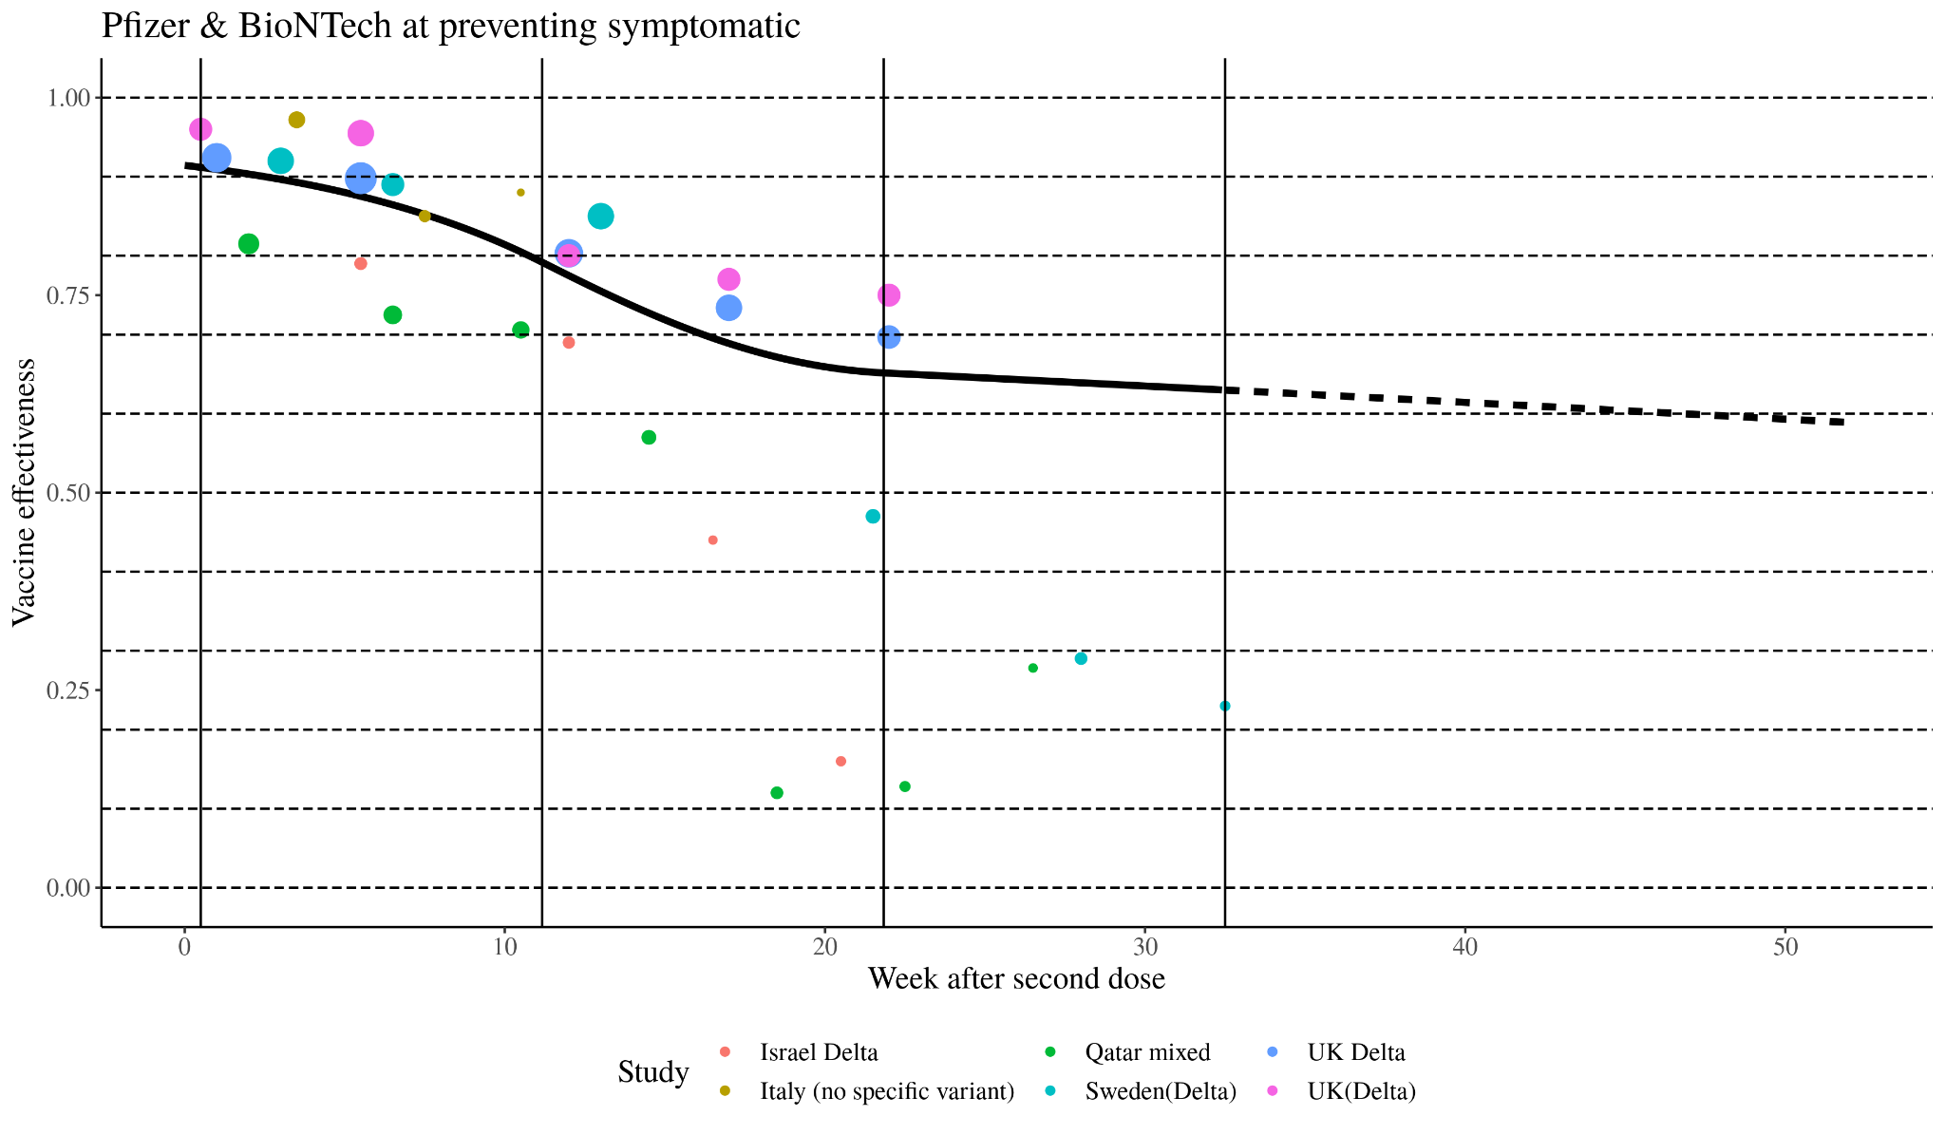
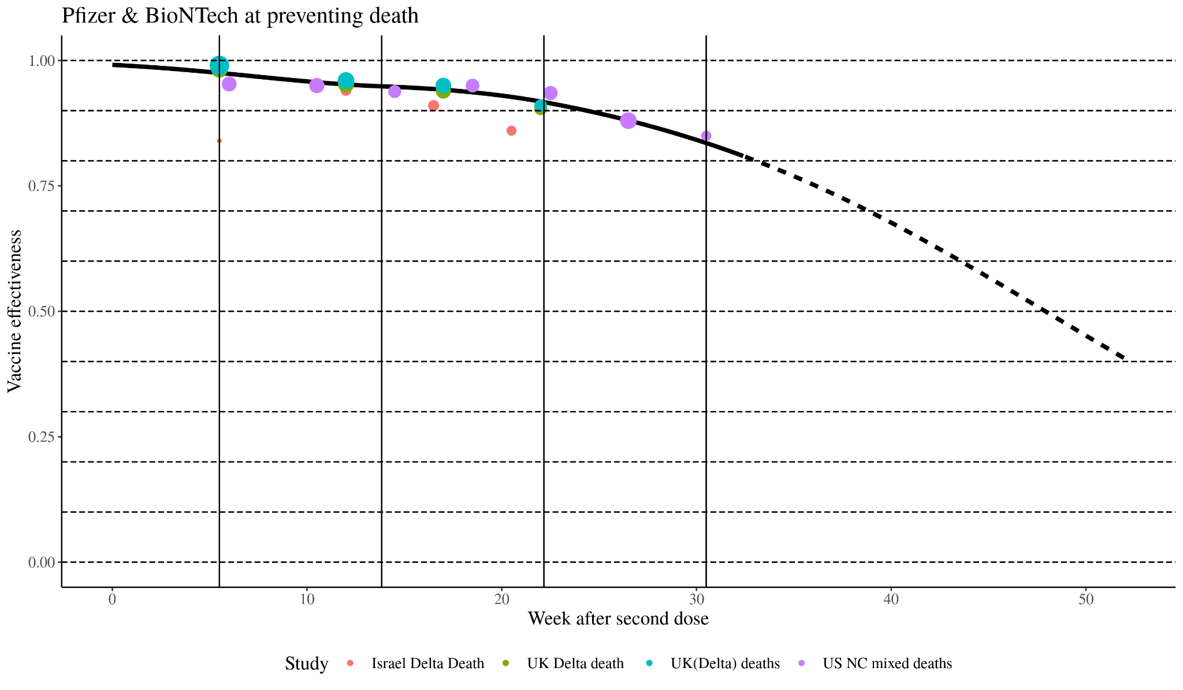
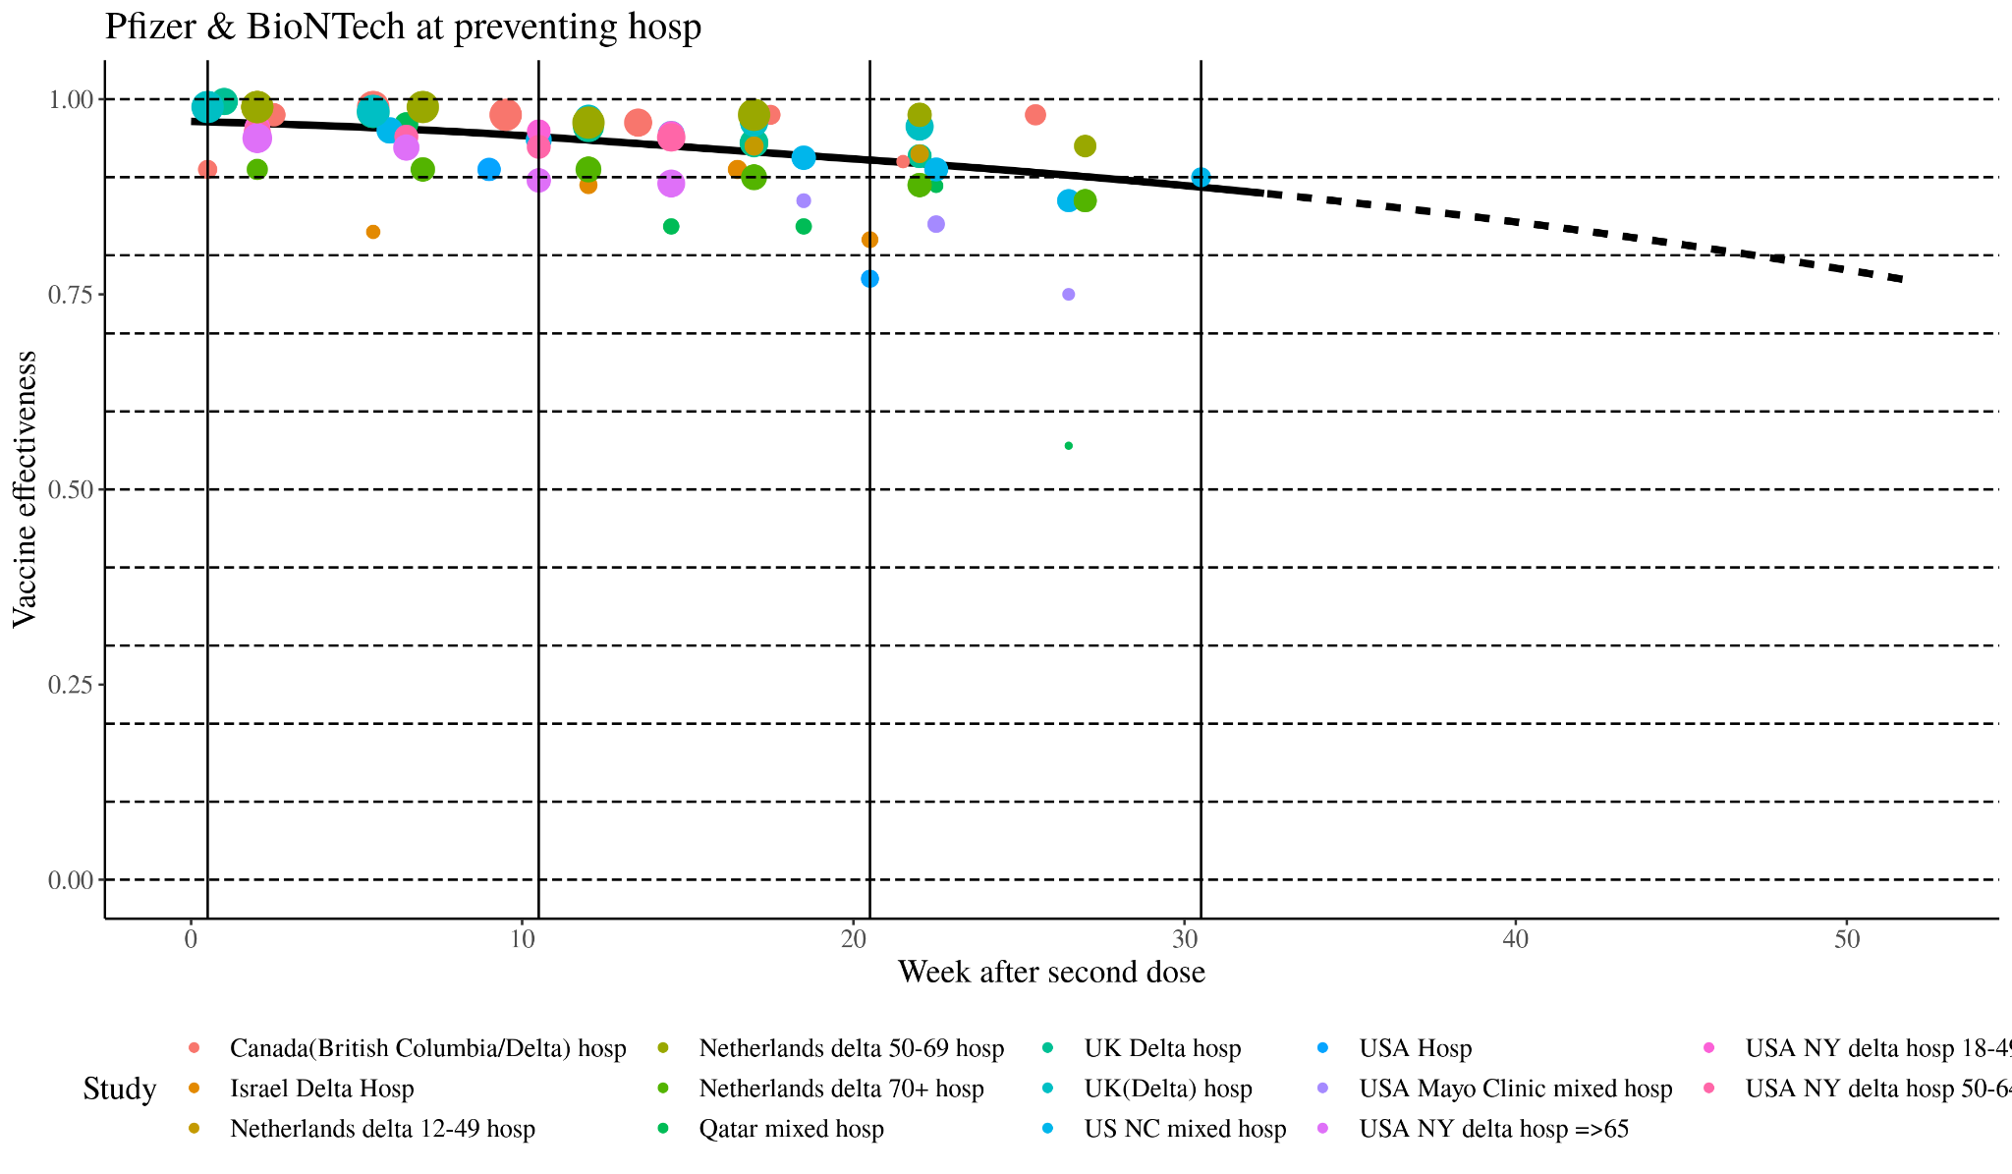
Preliminary results

Slide 6
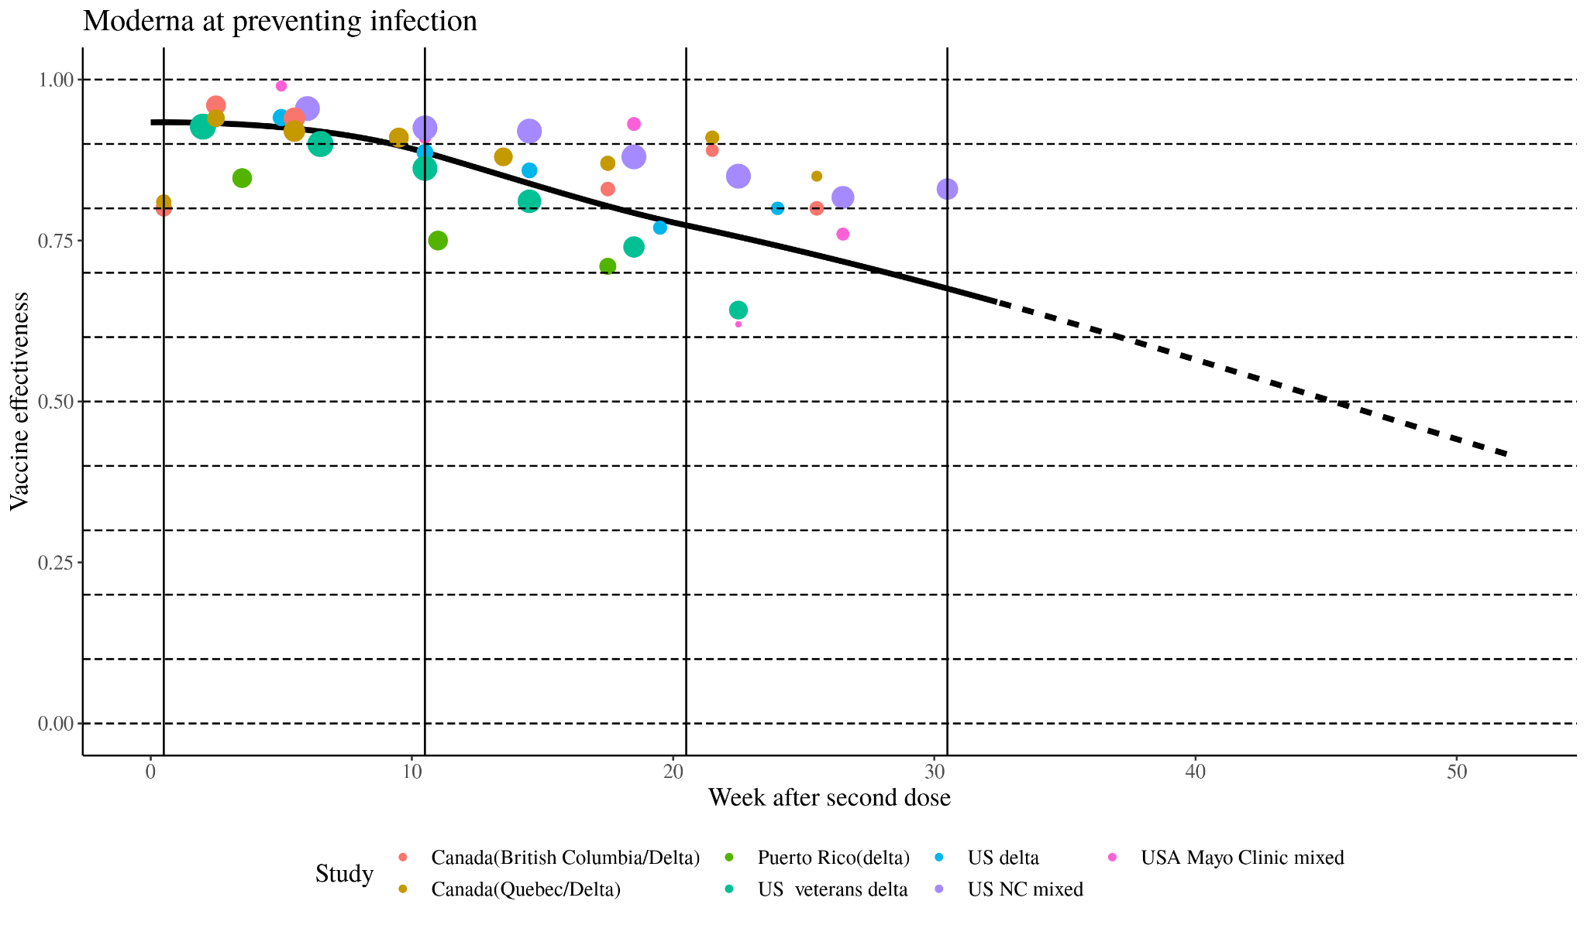
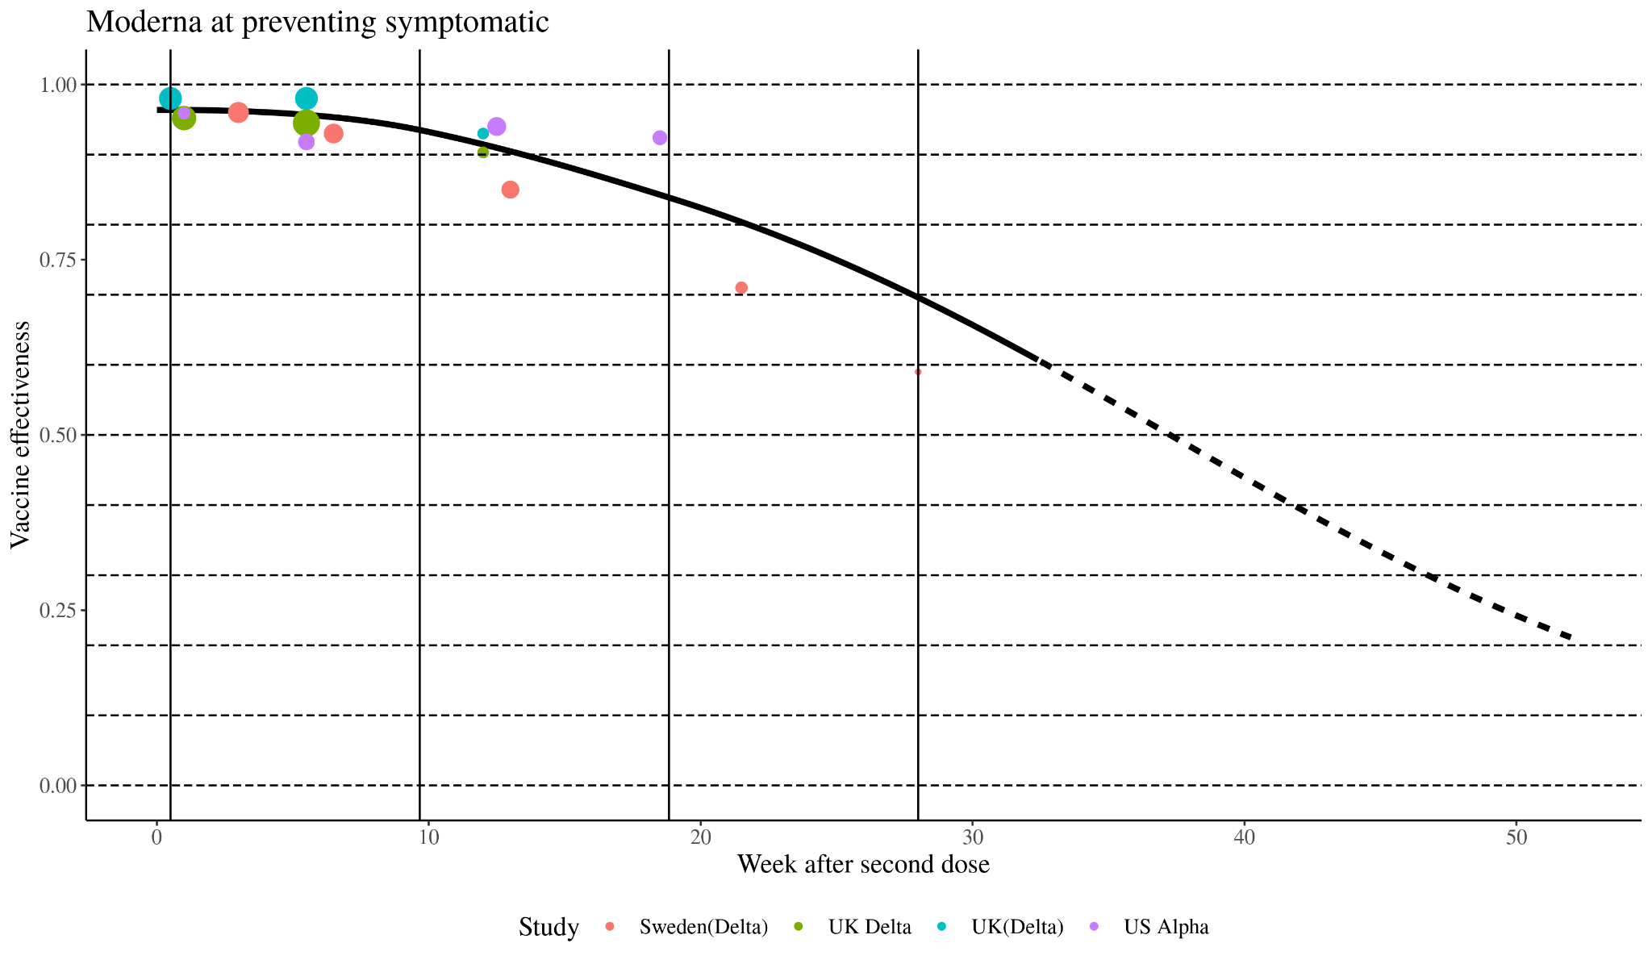
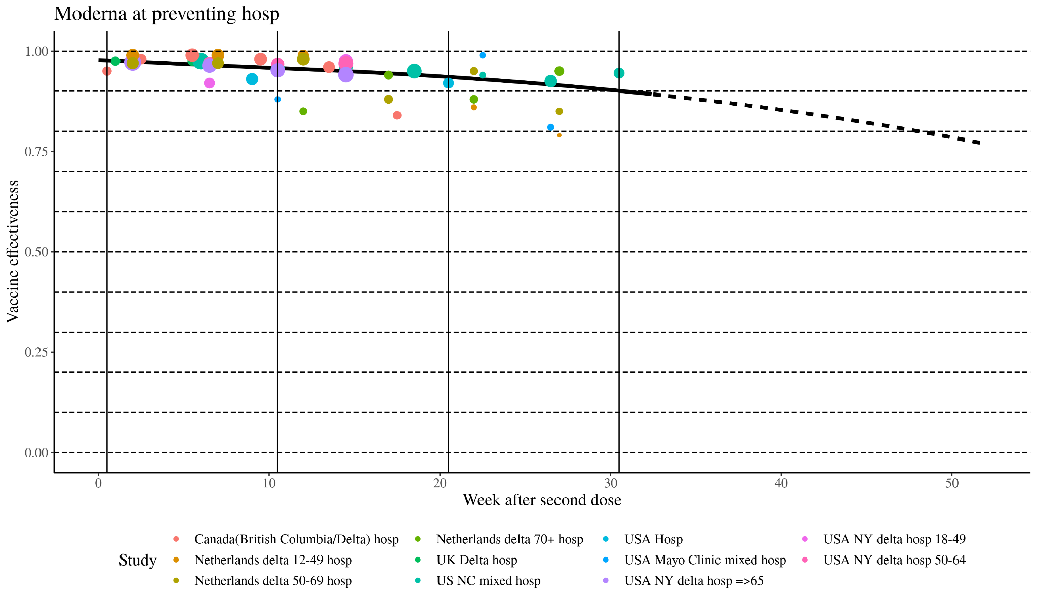
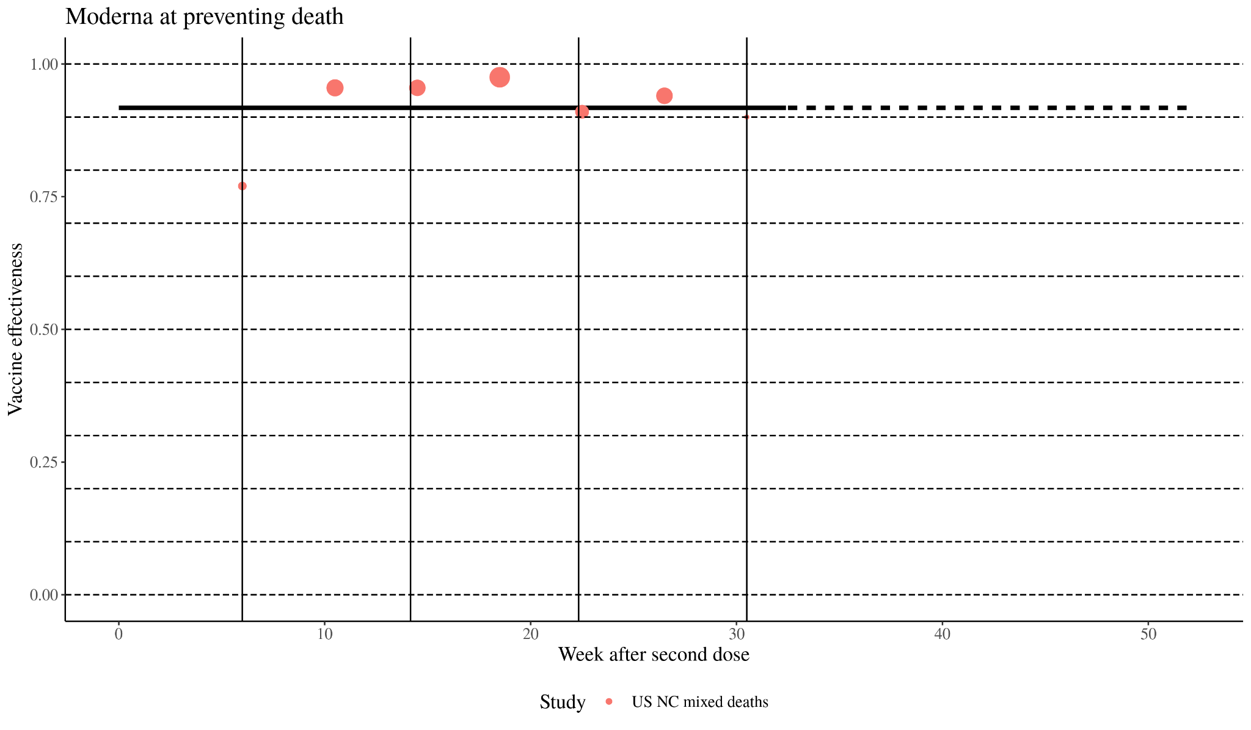
Preliminary results

Slide 7
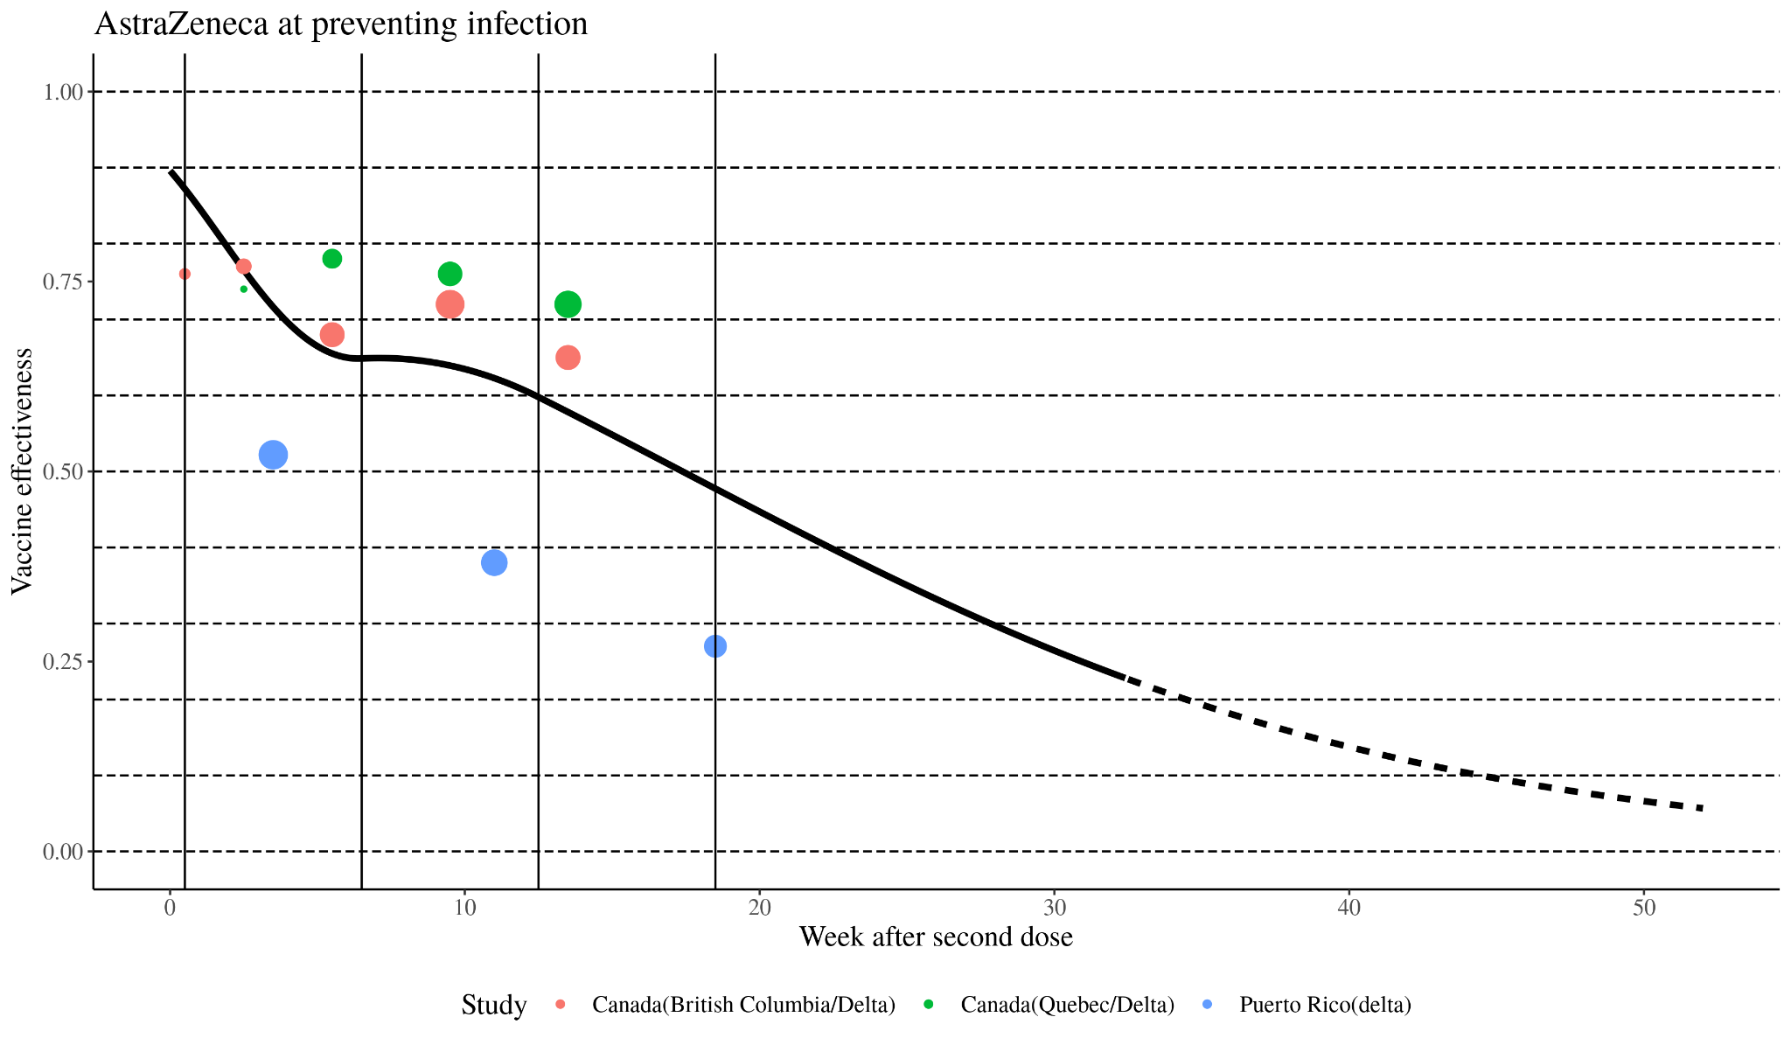
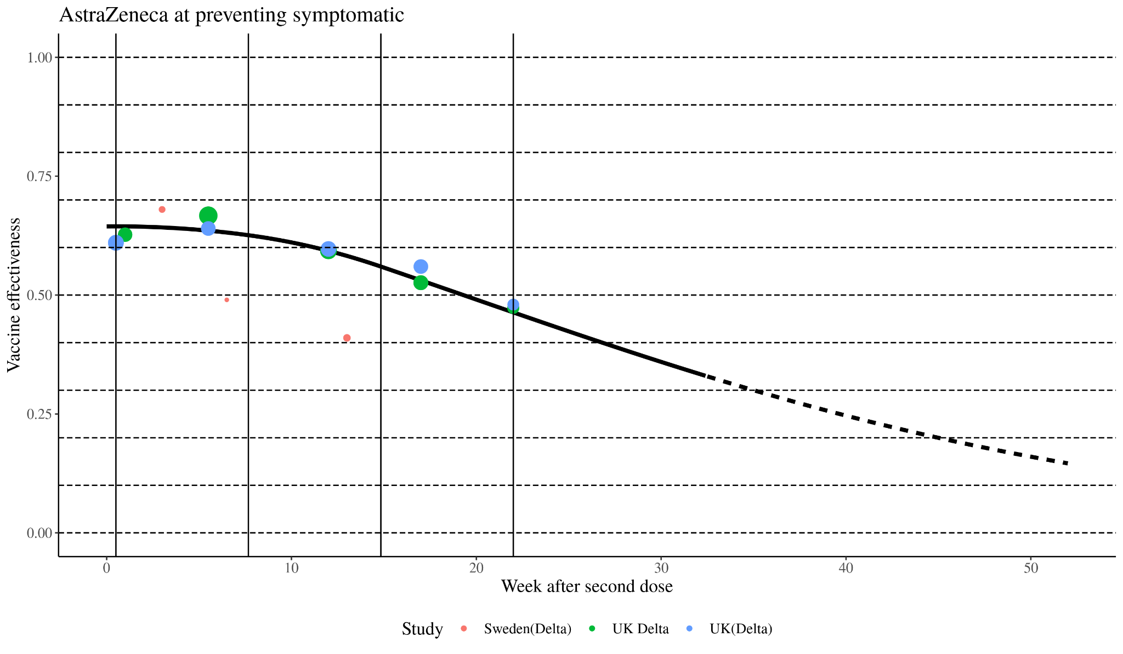
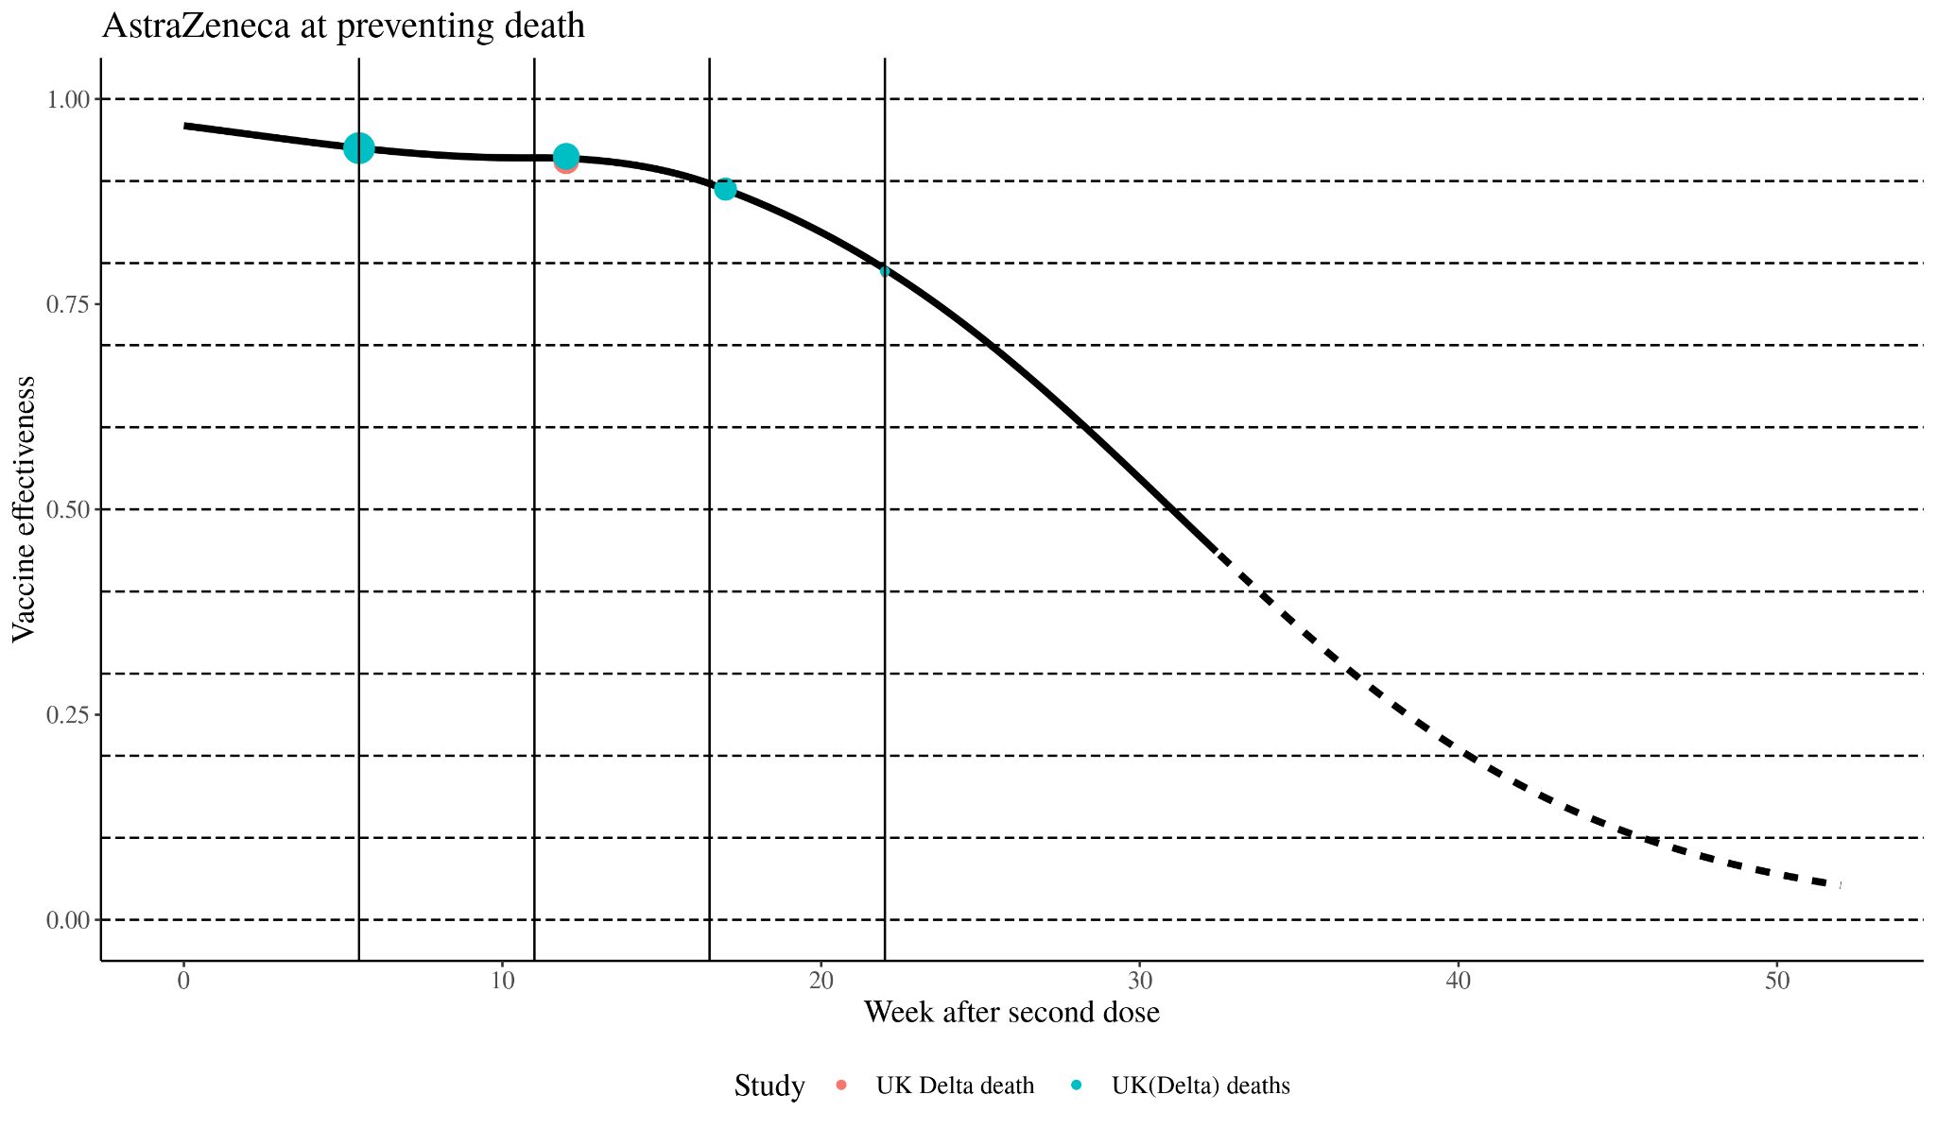
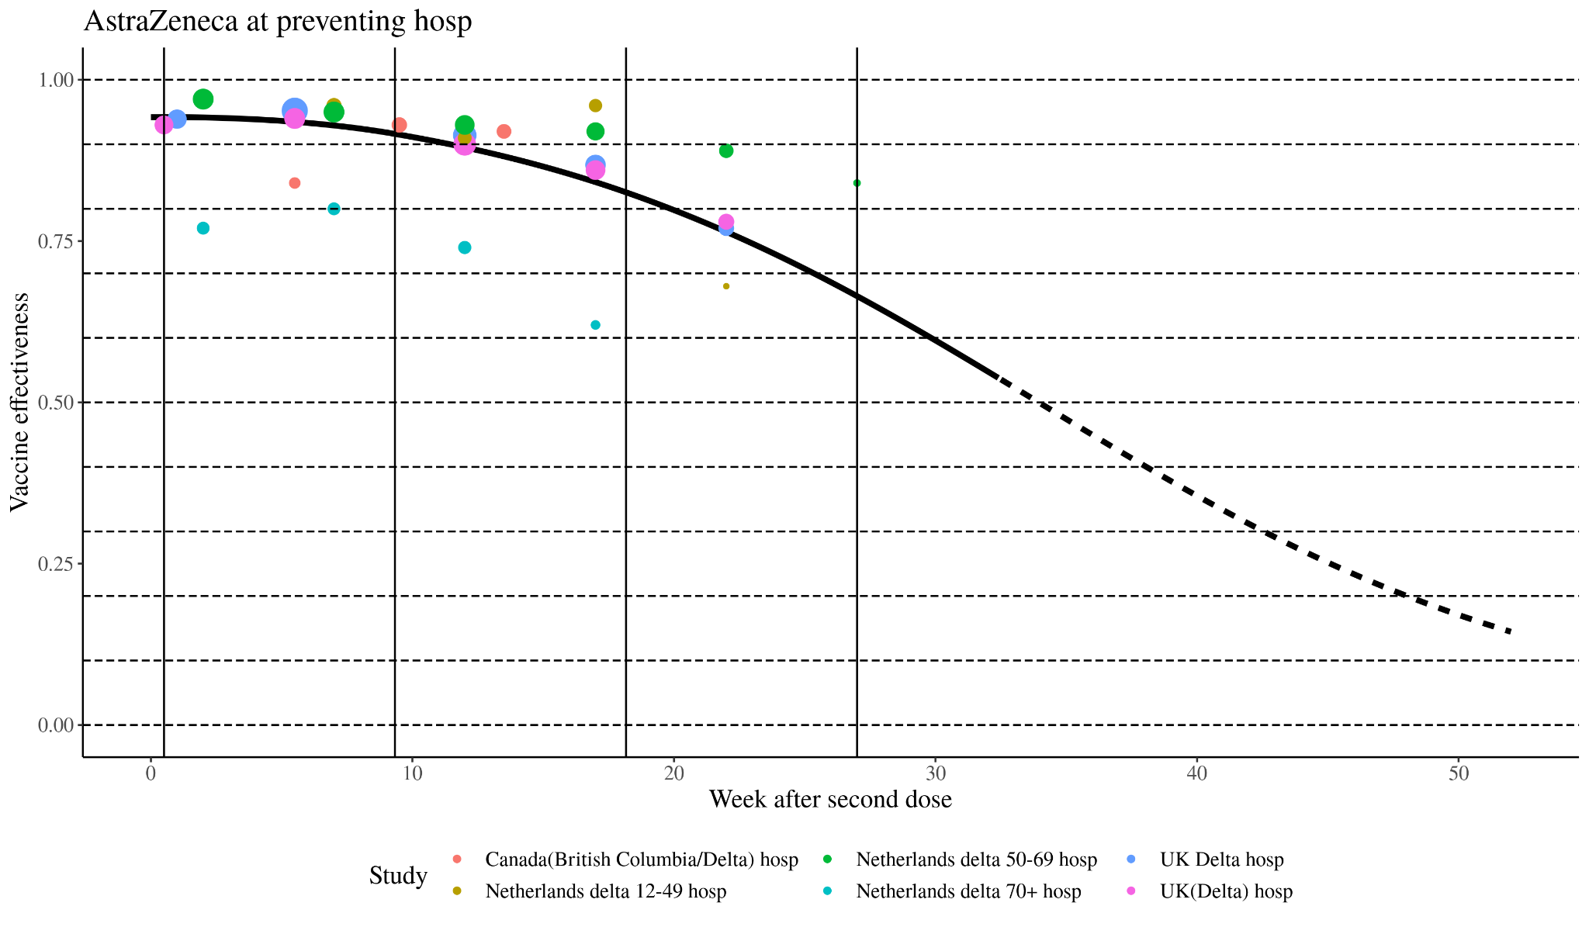
Preliminary results

Slide 8
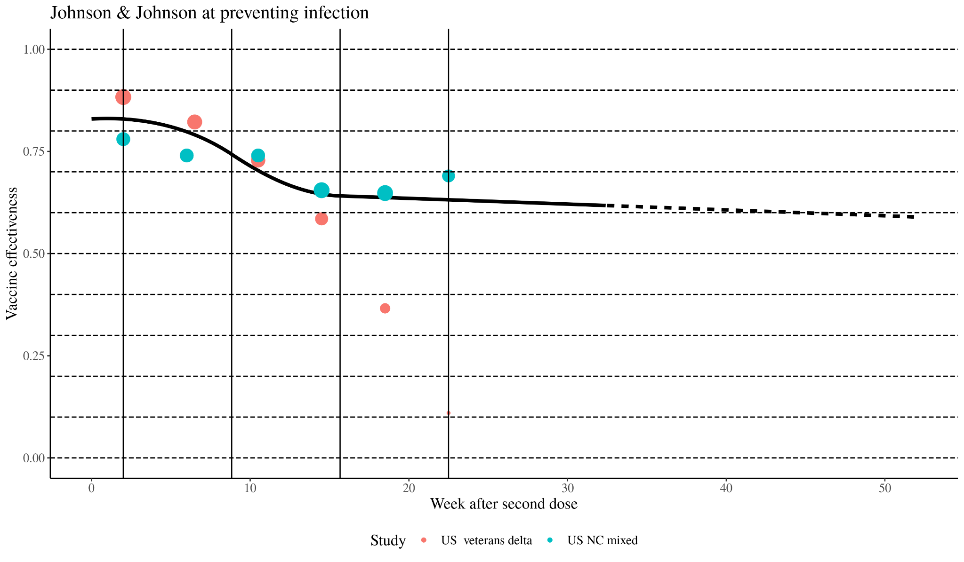
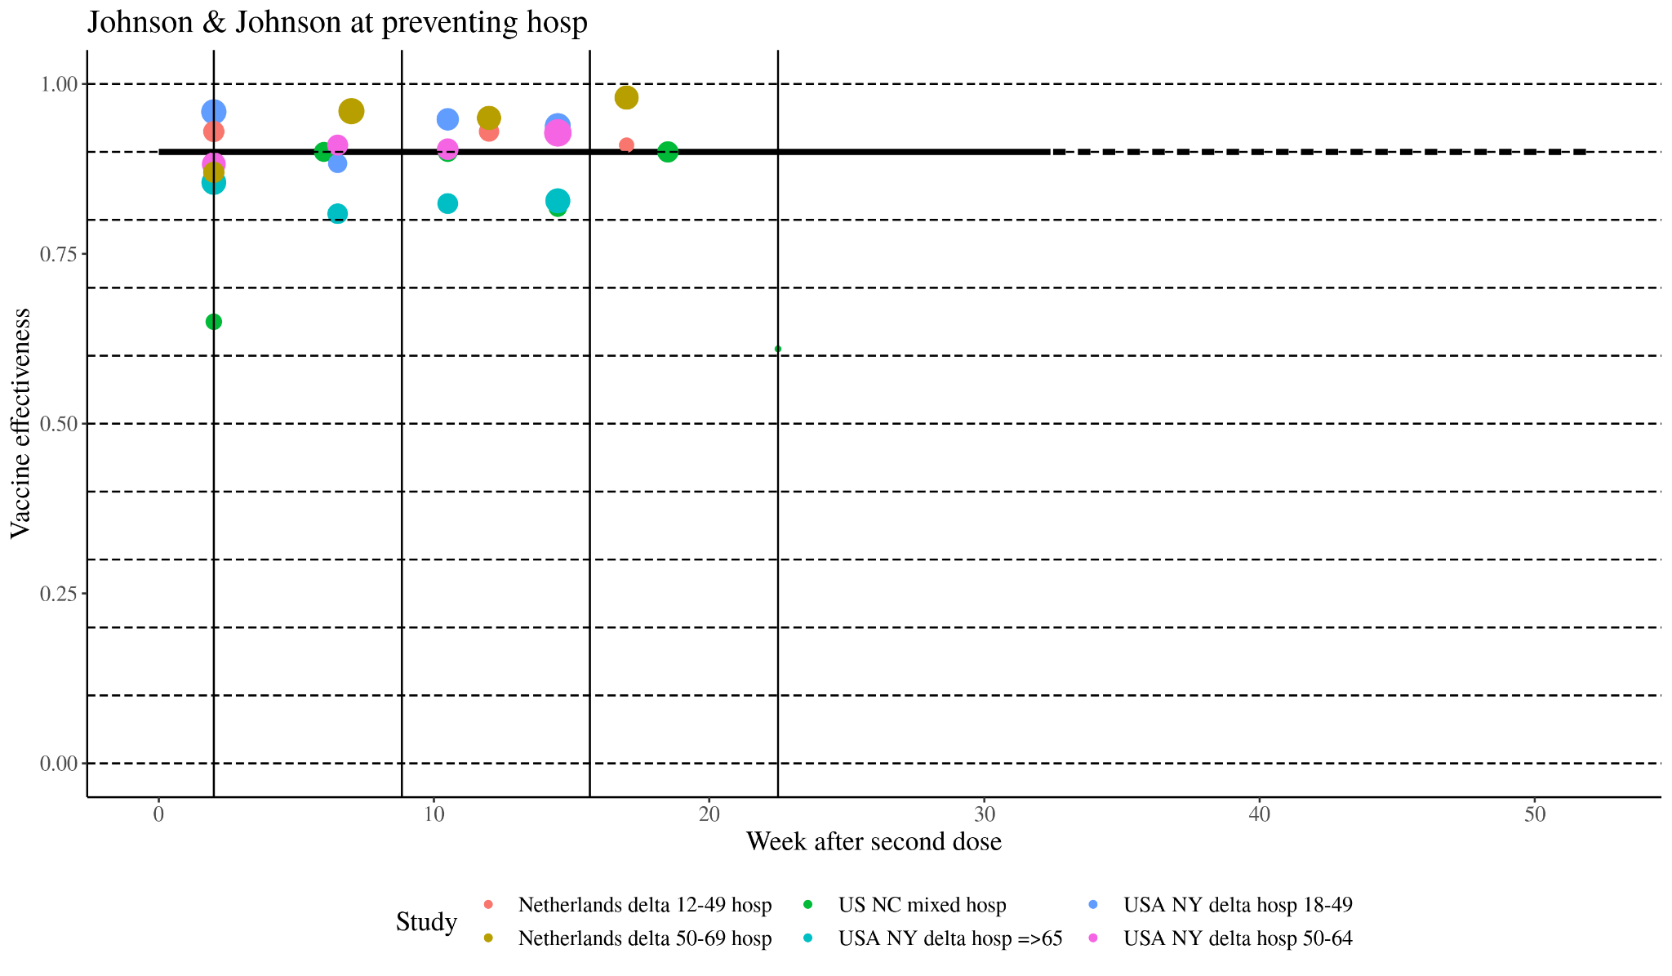
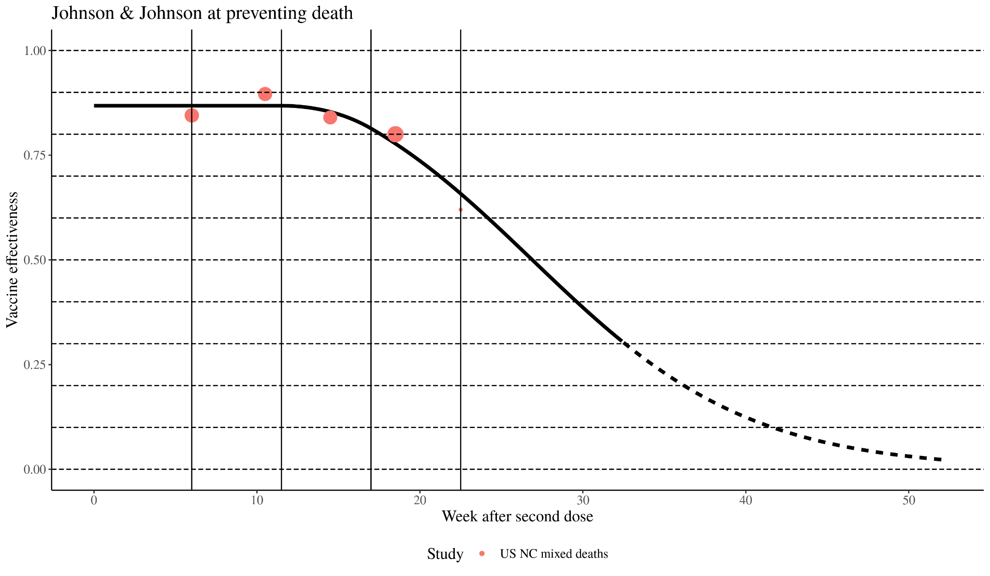
Preliminary results

